Slide 1
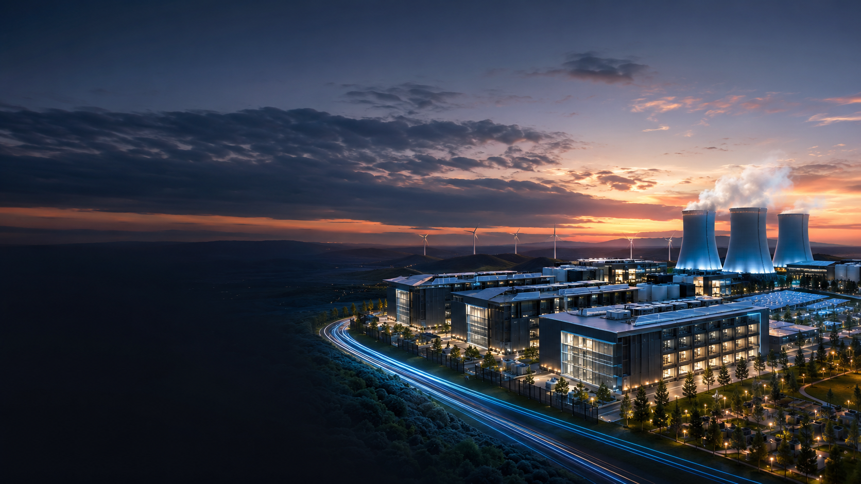
CEWT
Powering the
AI Revolution
Sustainably
A circular energy platform for hyperscale AI data centres
Reliable • Resilient • Circular
Clean Energy and Water Technologies Pty Ltd
Melbourne, Australia | July 2026

Slide 2
AI has created a new energy challenge
CEWT
The bottleneck for next-generation compute is no longer only chips — it is reliable, scalable infrastructure.
Grid congestion and connection delays
High availability requirements for AI workloads
Rising cooling and water constraints
Pressure to reduce lifecycle emissions
Key message
AI has become an energy infrastructure challenge, not simply a computing challenge.
AI deployment now depends on energy systems that can deliver power, cooling and resilience at scale.
Clean Energy and Water Technologies Pty Ltd
02

Slide 3
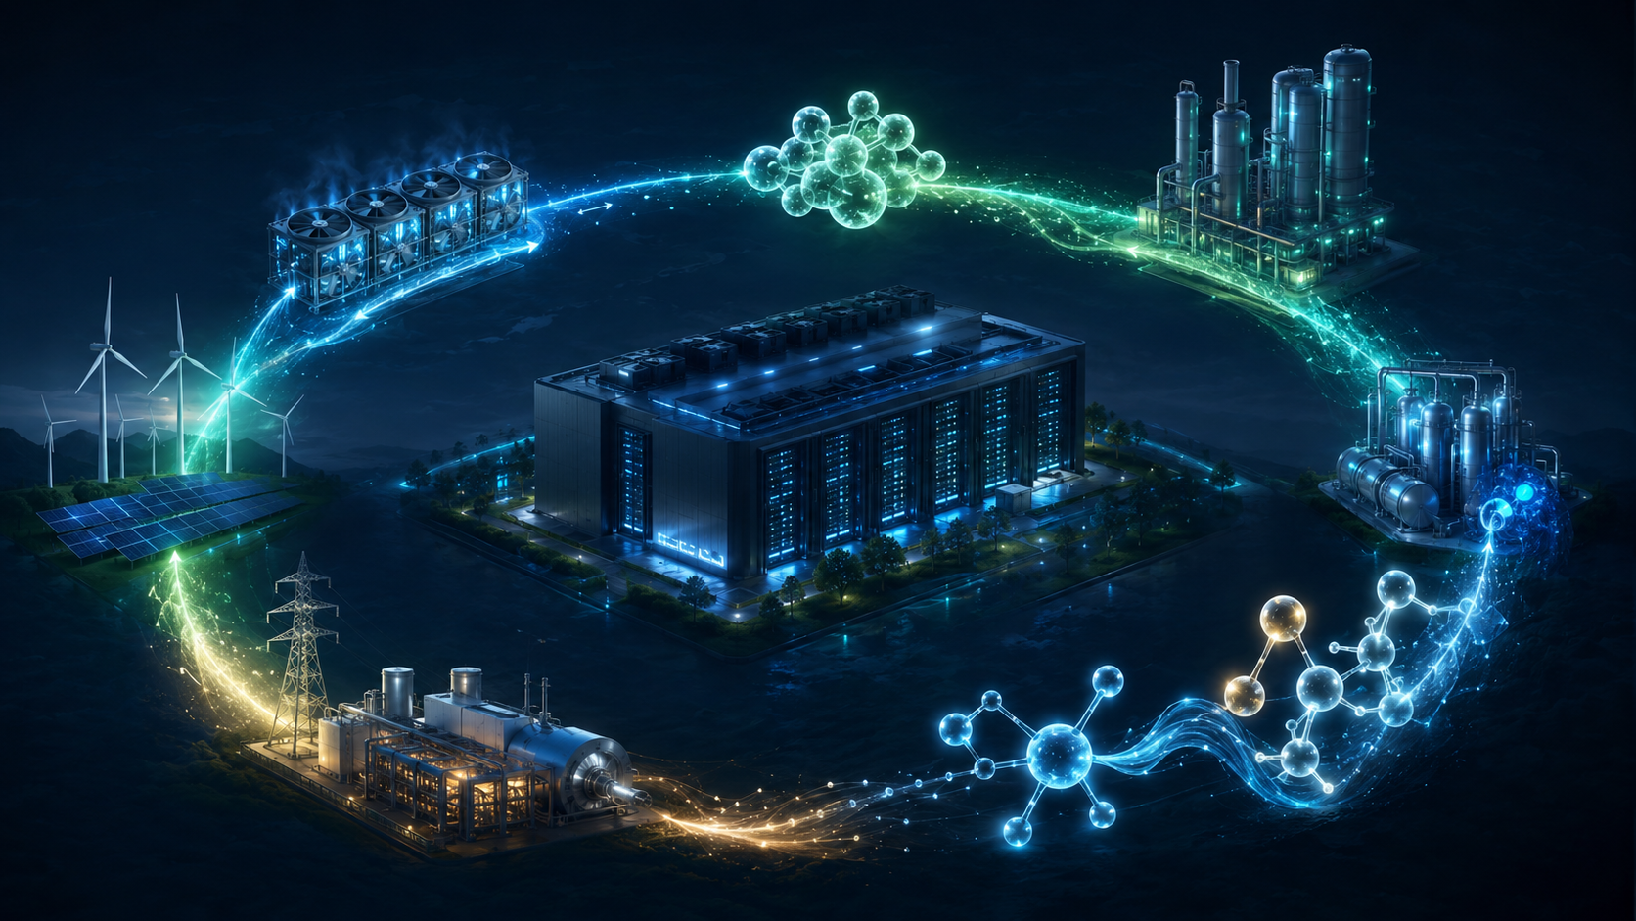
The opportunity: integrated energy systems
CEWT
AI campuses can be designed around power, cooling, heat and carbon flows as one system.
Instead of building larger one-way systems, build smarter circular systems.
Renewable electricity
Hydrogen production
Recycled CO₂
Methanation
Renewable synthetic gas
Onsite generation
Electricity + cooling + heat
AI data centre
The goal is not only lower-carbon power. It is a resilient energy architecture that supports uninterrupted AI operations.
Clean Energy and Water Technologies Pty Ltd
03

Slide 4
CRT-Trigen™: circular energy for AI data centres
CEWT
A modular platform combining carbon recycling, synthetic gas and trigeneration.
CO₂ capture → Methanation → Renewable synthetic gas → Power generation → Electricity + cooling + heat → CO₂ capture
Clean Energy and Water Technologies Pty Ltd
04

Slide 5
Why CRT-Trigen™ matters
CEWT
The value proposition is resilience, efficiency and circularity — not just electricity supply.
24/7 resilience
Integrated cooling
Heat recovery
Behind-the-meter generation to reduce exposure to grid constraints.
Power and cooling designed together for AI loads.
Useful heat can improve overall system efficiency.
Circular carbon
Hydrogen-ready
Modular scale-up
Captured CO₂ becomes a reusable carbon carrier.
Compatible with renewable hydrogen pathways.
Start at 20 MW, replicate and scale to campus level.
Differentiation: CEWT combines power, fuel, carbon and thermal flows into one integrated platform.
Clean Energy and Water Technologies Pty Ltd
05

Slide 6
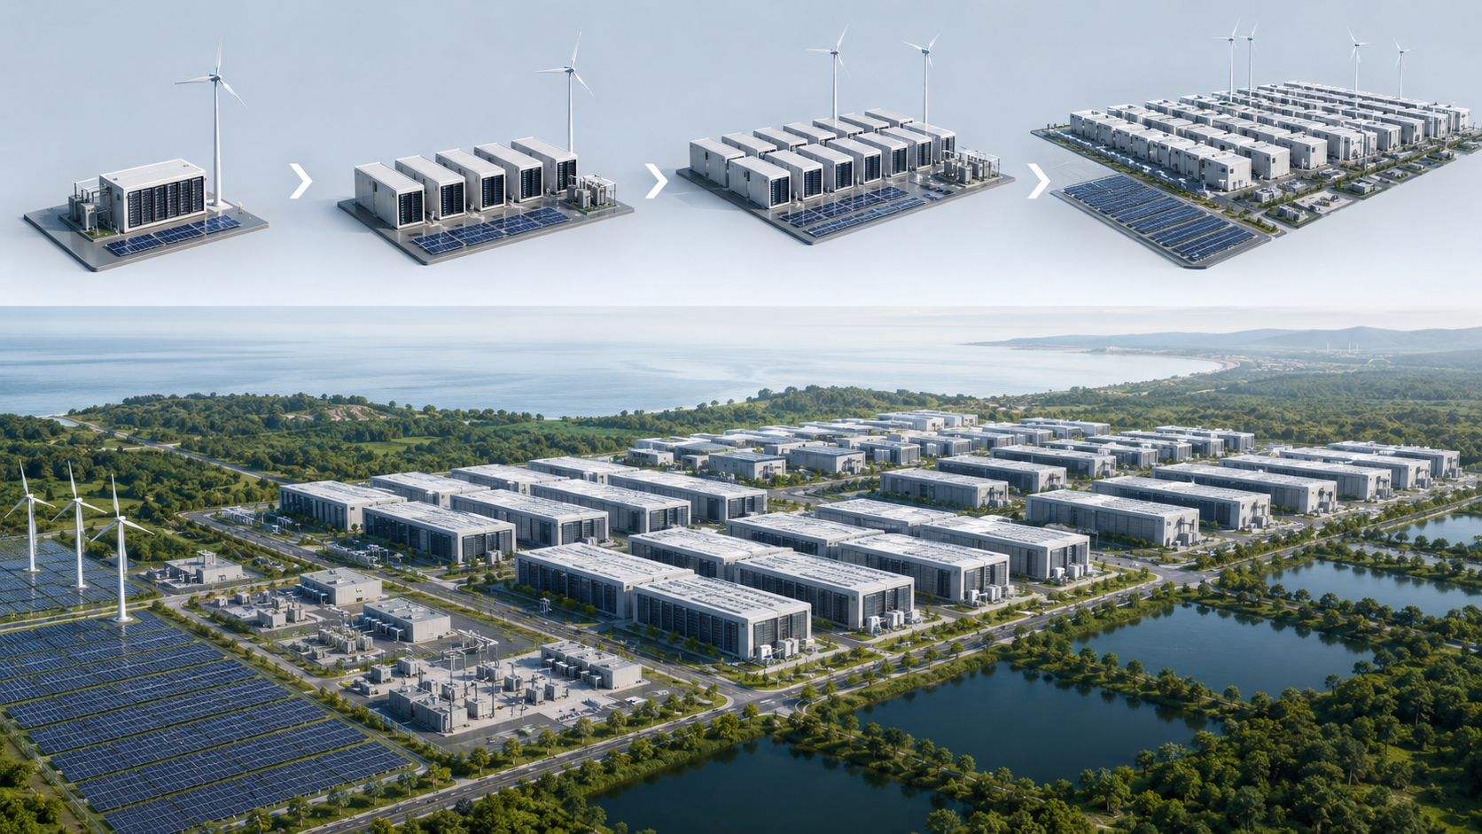
Commercial demonstration roadmap
CEWT
A practical pathway from first deployment to hyperscale campus integration.
20 MW
Demonstration
50 MW
Replication
100 MW
Scale-up
250 MW+
Campus supply
1 GW+
Hyperscale
Initial focus: a 20 MW CRT-Trigen demonstration that validates performance, integration and commercial replication.
Clean Energy and Water Technologies Pty Ltd
06

Slide 7
The market: AI infrastructure is becoming energy-led
CEWT
Developers and investors will increasingly prioritise secure power, water-aware cooling and fast deployment.
Strategic regions
Australia
Singapore
United States
Middle East
Europe
AI
24/7
20 MW→1 GW+
Energy
New baseload demand
Reliability requirement
Modular deployment pathway
Competitive advantage
Positioning: CEWT targets the intersection of AI infrastructure, energy resilience, hydrogen, carbon recycling and low-emission industrial development.
Clean Energy and Water Technologies Pty Ltd
07

Slide 8
Why CEWT now
CEWT
CEWT has moved from concept development into structured commercialisation.
Sep 2025
Australian provisional patent filed
2025–26
Technology architecture developed
2026
Engagement with technology providers
2026
WA Government submission lodged
Investor-ready workstream
Next
Commercial offer and financial model
Vendor-backed CAPEX and updated financial model to follow after Clarke Energy commercial proposal.
Next
20 MW demonstration partner
Clean Energy and Water Technologies Pty Ltd
08

Slide 9
Partnership opportunity
CEWT
CEWT is seeking strategic relationships to validate, finance and deploy CRT-Trigen™.
Technology
Investment
Deployment
EPC / EPCM partners
Strategic investors
AI data centre developers
Methanation suppliers
Infrastructure funds
Industrial campuses
Gas engine providers
Family offices
Government agencies
Hydrogen and CO₂ capture
Project finance partners
Utilities and offtakers
Near-term ask: feedback, introductions and potential collaboration around a 20 MW CRT-Trigen demonstration for AI infrastructure.
Clean Energy and Water Technologies Pty Ltd
09

Slide 10
CEWT
The future of AI will be enabled by resilient, intelligent and sustainable energy systems.
Clean Energy and Water Technologies Pty Ltd
Ahilan Raman | Managing Director
Melbourne, Australia
Email: ahilan.raman@clean-energy-water-tech.com
Reliable. Resilient. Circular.

